Slide 1
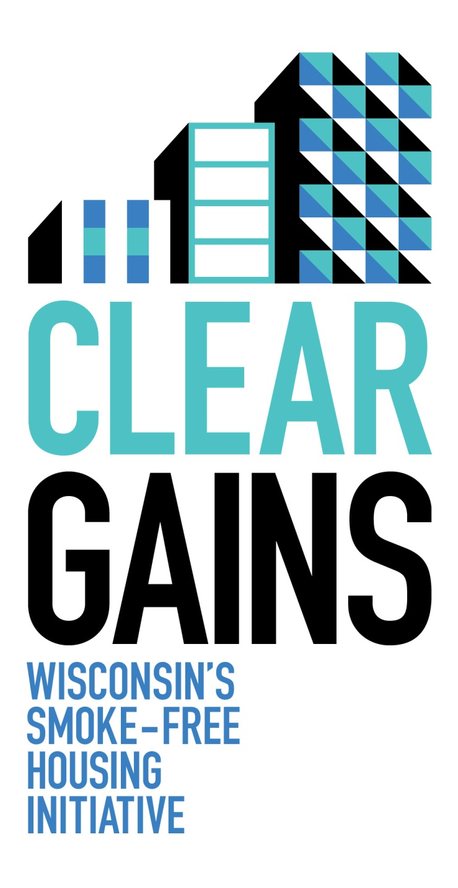
Emma Kane
American Lung Association
Emma.Kane@Lung.org
262-703-4842
www.wismokefreehousing.com
Notes:
We have known for a while now that smoking is harmful to the smoker’s health, but it is also harmful to your business’s bottom line.
Enacting a smoke-free policy in the housing you manage or own can save you money.

Slide 2
Clear Gains Vision
Smoke-free housing is available to all Wisconsin residents
www.wismokefreehousing.com
Notes:
Clear Gains is WI smoke free housing initiative. Our vision is that SF housing will be available to all WI residents.
To make that vision a reality, we work together with our partners from around the state to inform property owners about the business and health benefits of smoke-free policies.
If owners want to go smoke free , we assist them with this process.
We want everyone to enjoy the benefits of SF housing

Slide 3
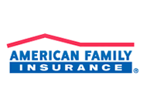
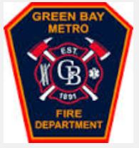
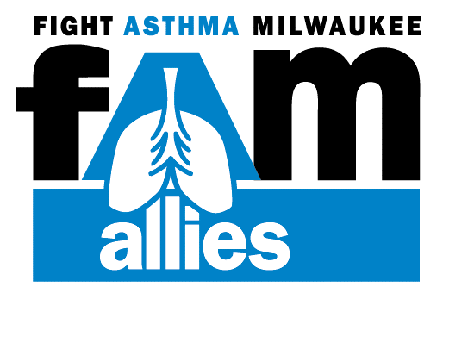
Clear Gains Network Partners
www.wismokefreehousing.com
Notes:
The Clear Gains Network is a collection of statewide organizations that provides support and guidance to Wisconsin's smoke-free housing initiative.
The Network's vision is a Wisconsin where smoke-free housing is available to all.
To make that vision a reality, the Clear Gains Network informs Wisconsin property owners about the business and health benefits of smoke-free policies in multi-family dwellings and provides resources for making residential properties smoke-free.

Slide 4
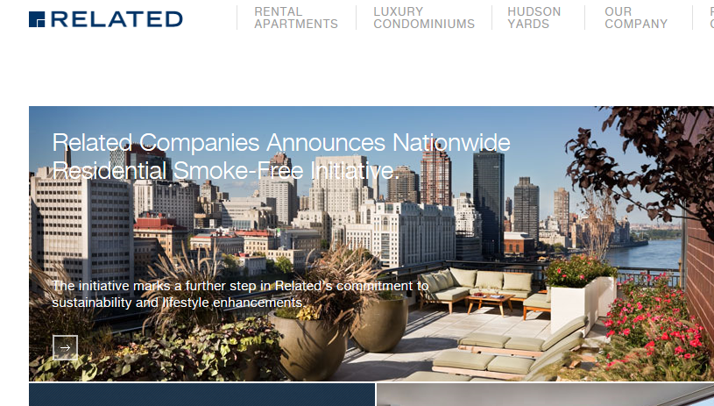
Smoke-Free Housing: A Billowing Trend
www.wismokefreehousing.com
Notes:
In June of last year, Related Companies became the first developer and owner to implement a nationwide smoke-free policy for all of its rental properties. This is over 40,000 units.
This trend is occurring in WI too. Millennium Housing Foundation has 15 properties throughout Wisconsin and they provide safe affordable housing to those with moderate to low incomes. All of their units are now smoke free.
Three sixty has 4 buildings, 78 units that are now SF
Ripple just went smoke free. They have a combination of multi unit, duplexes and SFH that are now SF representing 600 units.

Slide 5
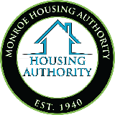
74 Housing Authorities are Smoke-free
www.wismokefreehousing.com
www.wismokefreehousing.com
Notes:
This trend is not just happening in private housing. Last September, Boston Housing Authority , which is one of the largest public housing authorities in the Nation, adopted a smoke-free policy for 100% of their properties. This provides its 25, 000 tenants a smoke-free living environment.
Recent data shows that there are 127 Public Housing Authorities in the State of Wisconsin. 74 of these have implemented smokefree policies including at least one of their buildings. As recently mandated by HUD, the rest must do so by July 31, 2018. – But we will get to that later.
(update as needed) Most recently, Monroe Housing Authority went smoke free in December of 2016 and the Dane Co. Housing Authority and Community Development Authority-Madison HA, have just started their implementation process with an effective date of January 1, 2018!

Slide 6
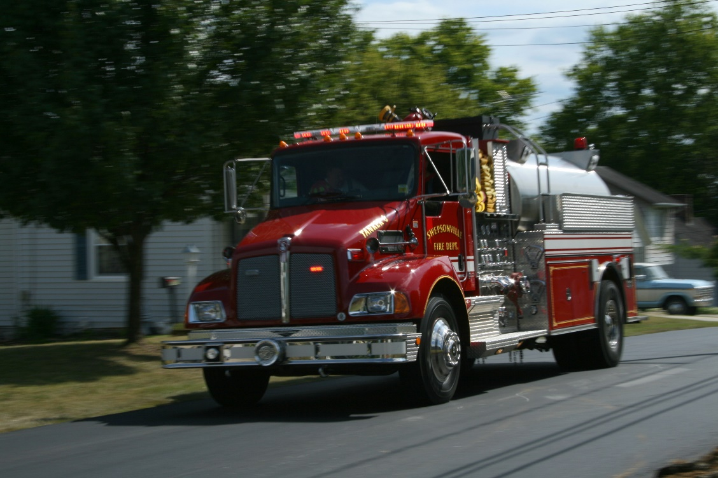
Importance of Smoke-Free Housing
www.wismokefreehousing.com
www.wismokefreehousing.com
Notes:
So now you’re probably thinking, okay so… what does this all have to do with the Fire Department?

Slide 7
Tobacco Use Impacts all EMS
Community Health
Resources and Resource Utilization
Fire Risk & Fatality
www.wismokefreehousing.com
www.wismokefreehousing.com
Notes:
Tobacco Use and smoking impact all emergency medical services.
From overall community health to the number of medical calls of or related to complications from tobacco use.
It also effects how resources are utilized and made available. Tobacco use is one of the most expensive behaviors on health care – costing Nearly $170 billion in direct medical care for adults annually.
And while all of these are important, I want to spend a little more time diving into the increased fire risk and fatality risk associated with tobacco use, especially as it relates to Multi family Dwellings

Slide 8
Fire Risk
On average, U.S. fire departments responded to:
A fire every 23 seconds
A structure fire every 63 seconds
A home fire every 86 seconds
An outside or unclassified fire every 52 seconds
A highway vehicle fire every 181 seconds
-NFPA, 2015
www.wismokefreehousing.com
www.wismokefreehousing.com
Notes:
First let’s talk a little about fire risk in general.

Slide 9
Smoking is the leading cause of home fire deaths
Leading causes of home structure fires:
www.wismokefreehousing.com
Notes:
When looking a little closer at the cause of homes fires especially, cooking fires still lead the pack
But interestingly, and tragically, smoking remains the leading cause of home fire fatalities.

Slide 10
Smokers aren’t the only victims
One-quarter of victims of smoking-material fire fatalities are not the smokers whose cigarettes started the fire
www.wismokefreehousing.com
Notes:
But smokers aren’t the only victims. According to data from NFPA, one –quarter of victims of smoking material fires are not the smoker whose cigarette started the fire.

Slide 11
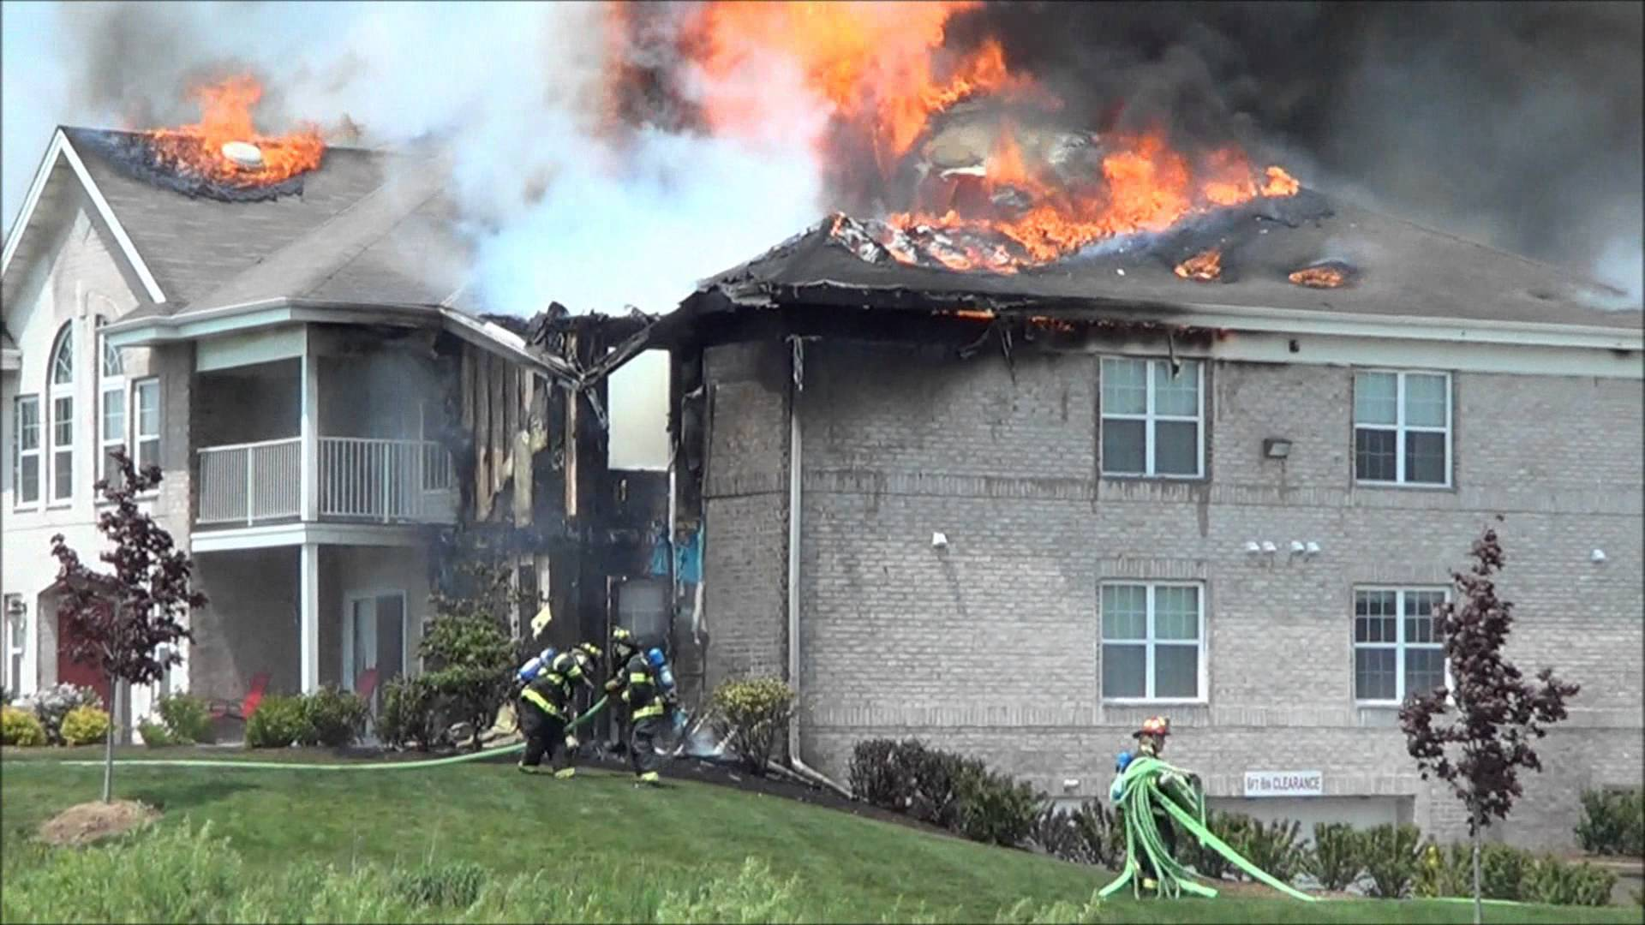
www.wismokefreehousing.com
Notes:
In the context of Multi Family Dwellings this risk becomes very, very real.
In these homes, not only does a smoker make the choice to risk his or her health and safety, when they live in a multi unit complex, every other human is forced to assume that same risk.
Where is their protection?

Slide 12
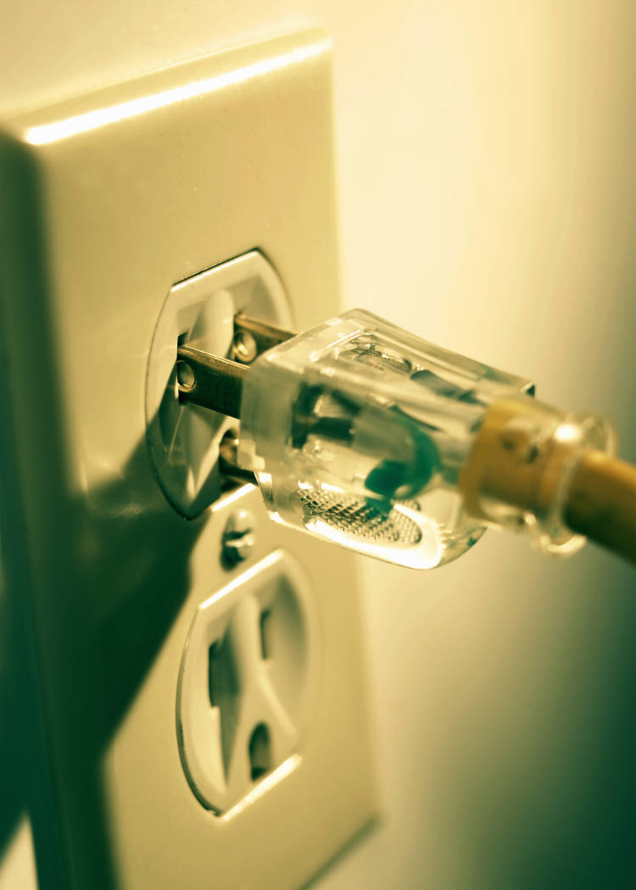
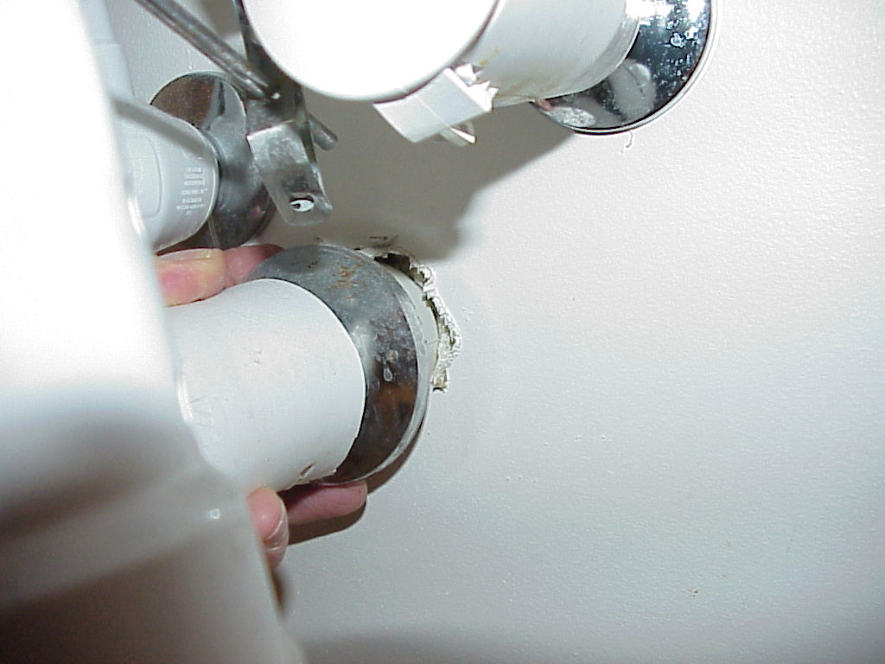
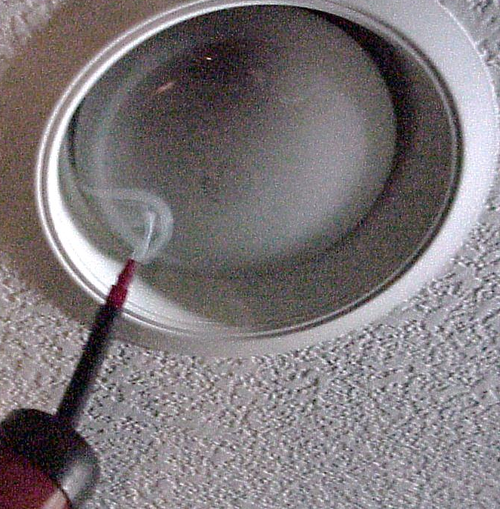
Secondhand Smoke Doesn’t Discriminate
Notes:
This risk is true not only for fire hazard but also the health consequences of second hand smoke.
Secondhand smoke can travel through gaps along baseboards, electrical outlets, shared heating and ventilation systems, through light fixtures, and in and out of doorways and windows. The path smoke takes through buildings is hard to predict and difficult if not impossible to stop.
Smoke travels through tiny cracks and crevices, involuntarily exposing individuals in adjacent units.
Cite: Center for Energy and Environment

Slide 13
“There is no safe level of exposure to secondhand smoke.
Any exposure is harmful.”
- US Surgeon General
www.wismokefreehousing.com
www.wismokefreehousing.com
Notes:
According to a Wisconsin survey, by the center for Urban Initiatives and Research,
54% of renters in apartment buildings that allow smoking are concerned about the health effects of secondhand smoke from other units.
And they should be. The US Surgeon General has said, “There is no safe level of exposure to secondhand smoke.
Any exposure, even small amounts, can be harmful.
Secondhand smoke has been classified as a carcinogen which can lead to lung cancer. It can also cause an increased risk of heart attacks and exacerbate asthma and other lung diseases, for both smokers and non-smokers alike.
The bottom line is, there is no safe level of exposure to secondhand smoke.

Slide 14
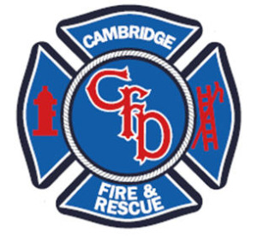
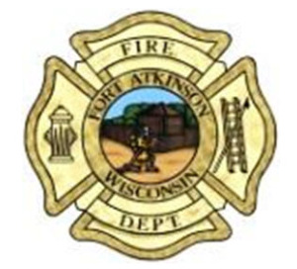
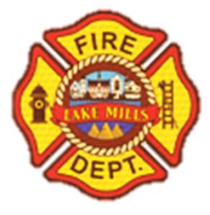
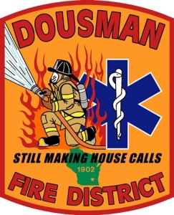
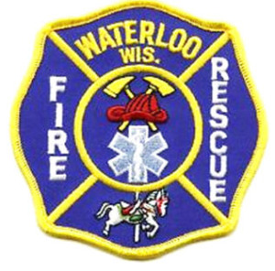
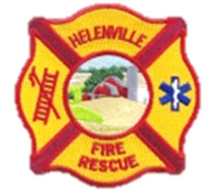
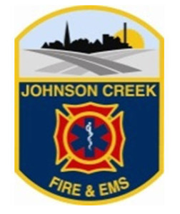
www.wismokefreehousing.com
Notes:
That’s where Clear Gains comes in, and that’s where EMS is perfectly situated to save lives.

Slide 15
Why Clear Gains?
CG is on the cutting edge of the SFMUH movement with fire departments as leaders
CG Network partners spoke at the White House regarding 2016 HUD Smoke-Free Ruling
IAFC Course on SFMUH the July
Involvement from CG network partners and many WI fire departments
www.wismokefreehousing.com
Notes:
So why would you be interested in joining Clear Gains.
Well this initiative is truly on the cutting edge of the SFMUH movement with Fire departments as leaders in efforts.
Network partners play an active role in SFMUH efforts, speaking at the White House about the HUD SF Ruling and participating in the creation of an upcoming international association of fire chiefs course on SFMUH

Slide 16
Why Clear Gains?
CG is another tool in your toolbox
Resource connections!
Signage
Cessation
Enforcement
www.wismokefreehousing.com
Notes:
Ultimately, CG is just another tool in your tool box. Through the network departments are connected with resources that can provide messaging, materials and support.

Slide 17
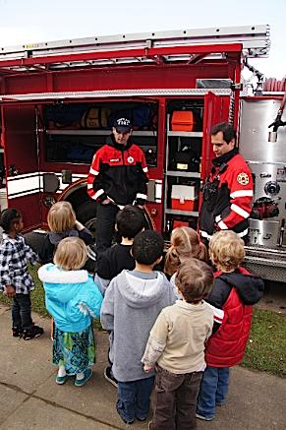
Why Clear Gains?
Outreach & Education compliment existing fire prevention work
Takes prevention and education efforts to the next level
www.wismokefreehousing.com
Notes:
Additionally, the outreach and education that accompanies CG is a compliment to existing work fire departments already do – it simply takes your efforts to the next level.
In doing some research about fire prevention and education campaigns, I noticed most centered around what to do if there is a fire – “how to get out” or “what to know about fire” but very little talked about concrete ways to strategically prevent the source of a fire. And aside from messages from FEMA advising to “smoke outside” little to nothing was said addressing the high risk of smoking and multi family dwellings.

Slide 18
Join the Clear Gains Network
www.wismokefreehousing.com
Notes:
This is where Clear Gains stands to add the most value. Through collaboration with partners across the Clear Gains network, fire departments can be on the cutting edge of fire prevention and ultimately, fatality reduction.

Slide 19
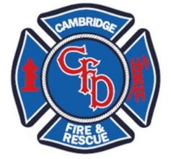
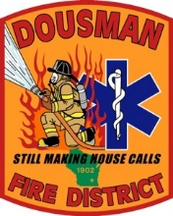
Join the Clear Gains Network
www.wismokefreehousing.com
Notes:
I hope you will consider joining our network!
Let’s put Jefferson County fire on the map! Join the likes of Madison Fire, Milwaukee Fire to help make Jefferson a healthier, safer place to live.

Slide 20
Questions?
Emma Kane
Emma.Kane@Lung.org
262-703-4842
Jaime Zach
Jaime.Zach@Lung.org
262-703-4834
www.wismokefreehousing.com
Notes:
There are clear gains to smoke-free housing – you can save money and have cleaner and safer buildings.

Slide 21
Public Housing Mandate
www.wismokefreehousing.com
Notes:
On November 30, 2016 HUD (Housing and Urban Development) announced that public housing developments in the US will be REQUIRED to go smoke-free.
The rule finalized in February of 2017 and allows 18 months for housing authorities to go smoke-free.
Nationally over 3000 public housing agencies will be implementing a smoke-free policy by July 2018.
This rule prohibits the use of cigarettes, cigars, pipes and hookahs in all living units, indoor common areas, administrative offices and outdoor areas within 25 ft. from the buildings.
The rule does not cover, mixed finance development, section 8 housing or electronic cigarettes.
Housing authorities have the right to further restrictions as they see necessary (including e-cigs, property-wide smoke free policy, restrict smoking in certain areas, etc.)

Slide 22
Smoke-free Public Housing
Reduce tobacco use
Reduce secondhand smoke exposure
Save money
Notes:
Improve the health of very low-income tenants by reducing secondhand smoke exposure
Reduce tobacco use among low-income smokers if policies are combined with treatment
Save over $15 million dollars/year in maintenance costs
Save about $500 million dollars/year in health care costs
Over 700,000 units would be affected by this rule (including over 500,000 units inhabited by elderly households or households with a non-elderly person with disabilities)
There are also over 775,000 children in these units.

Slide 23
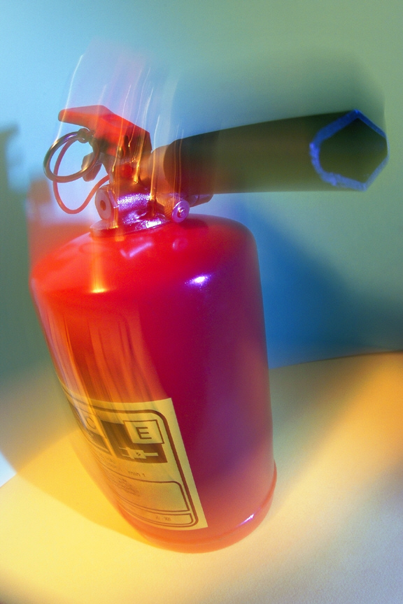
Less Risk of Fire Damage
www.wismokefreehousing.com
Notes:
***Fire damage video hyperlinked to picture- https://www.youtube.com/watch?v=CYkEgzVoB7U&list=TLRW-UuqL4l4P8j4c-UI3iWvcvRHNv1eF6
A smoke-free policy means decreasing the risk of fire and the costs associated with fires.
Cigarette smoking is the leading cause of fires in multi-unit housing buildings. The cost of these fires average about $20,000 in loss per fire.
So, if someone falls asleep with a cigarette or doesn’t dispose of it properly, both your property and the lives of your tenants are at risk.
If a fire occurs, the damage will need to be repaired in the smokers unit, and likely other units as well. Tenants may have to relocate while the units are being repaired. If they relocate, then might not return, another financial loss.
[If there have been any local stories in the news about smoking caused fires, reference here]
Cite: See reference on Clear Gains in Smoke-Free Housing

